Slide 1


Slide 2


Slide 3



Johnny Xmas
Director of Training
@ GRIMM.RIP
Network Engineer
Systems Engineer
Information Security Engineer
Information Security Consultant
Penetration Tester
OT Researcher
Sneakerbot Blade Runner
Pharmacy Technician
Music Major
Burbsec Core Staff

Slide 4


Chris Carlis Red Team. Don’t Worry about it.
Does crime for a living
Captcha verified he is human
Looks like Johnny for the plausible deniability

Slide 5


Slide 6
You should 100% try out the stuff we are about to talk about here.
It’s super fun and you probably won’t get fired or sued.
We’re not lawyers but we are on stage so that probably counts for something, right?
Good Luck!

Slide 7


Slide 8

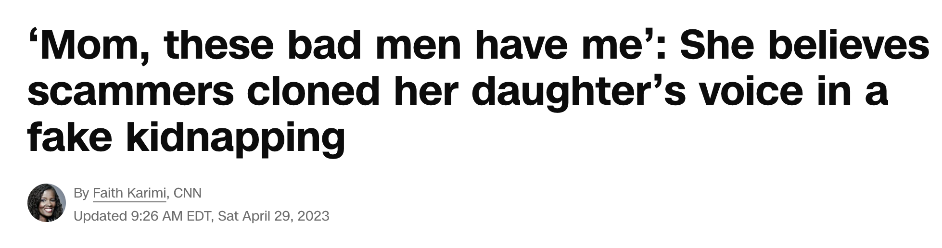
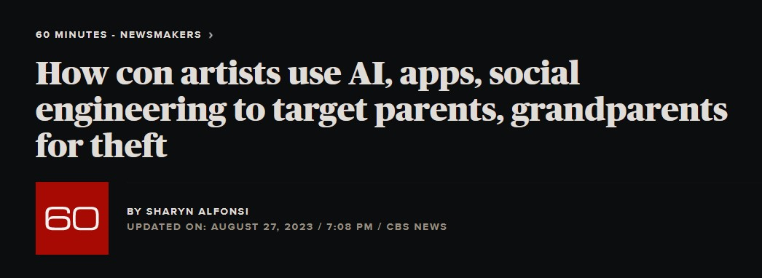
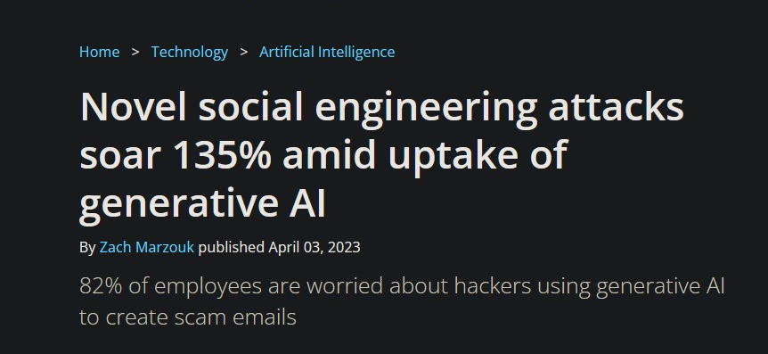
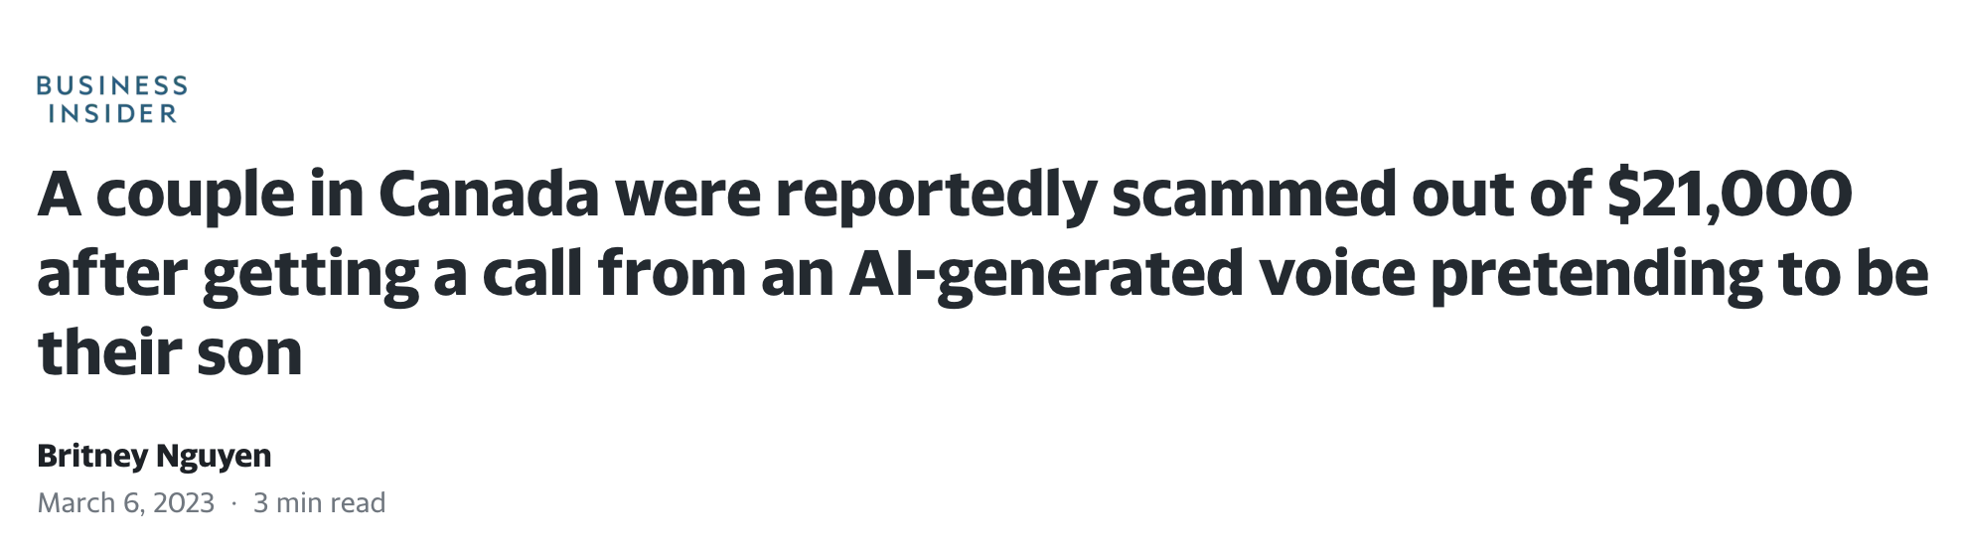
A.I. Trouble

Slide 9
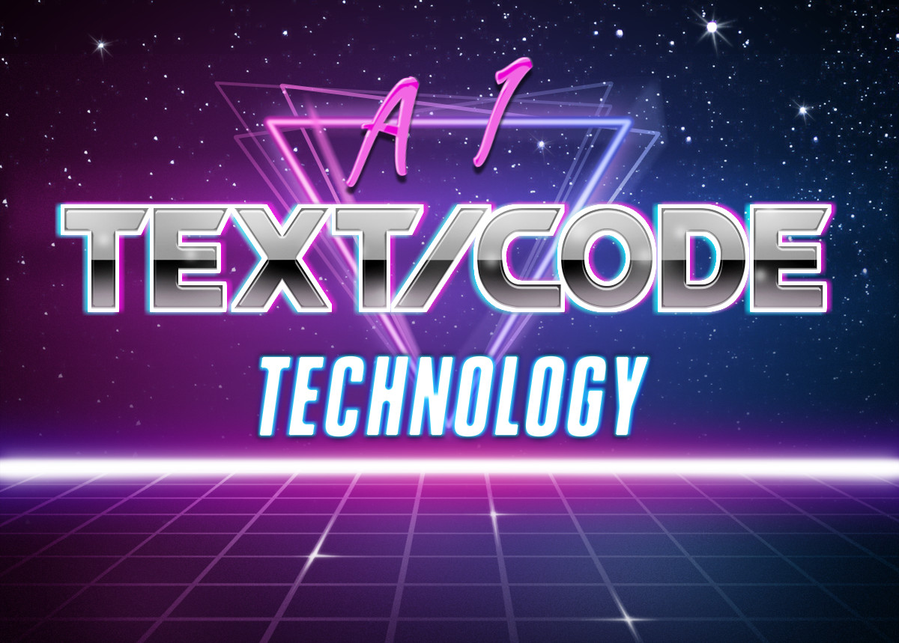

Slide 10

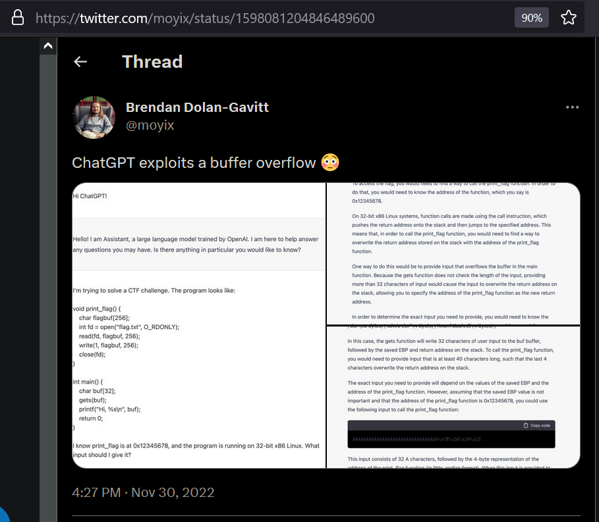
A.I. Text/Code Examples

Slide 11

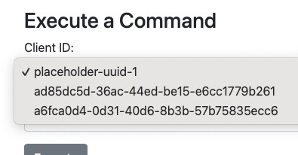
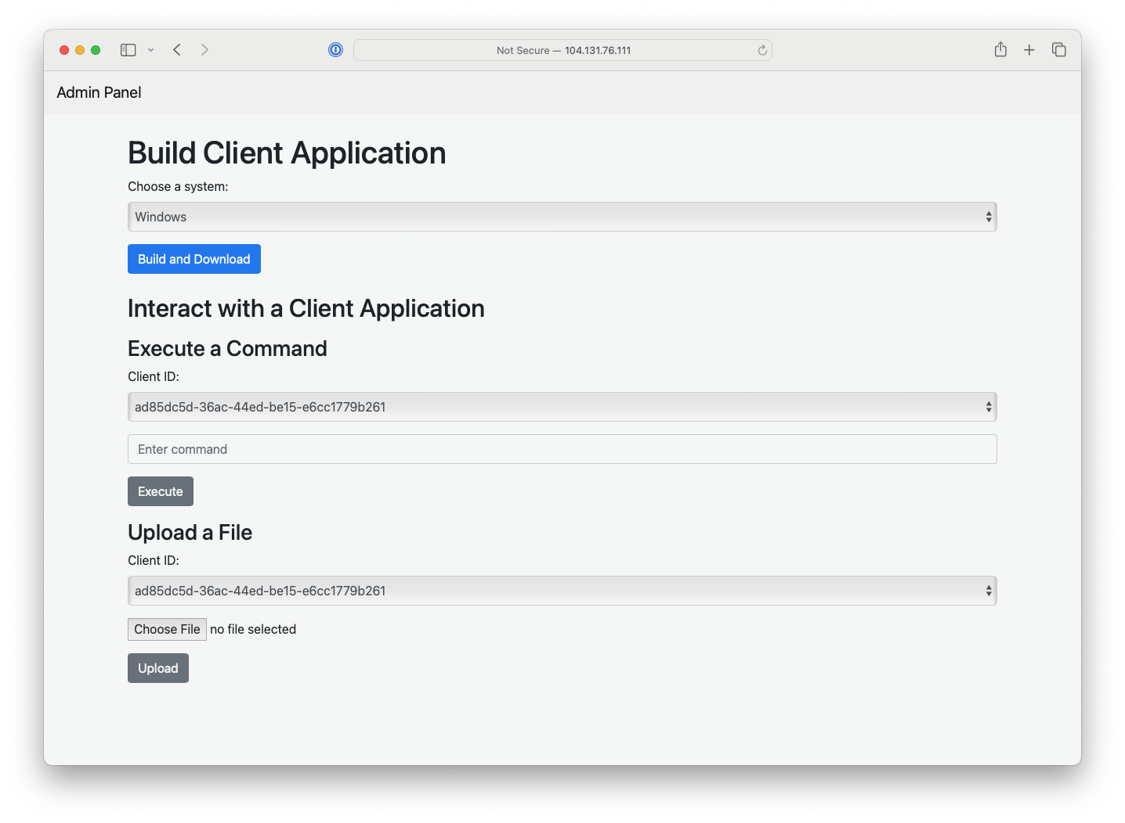
Tom’s No-Work C2
100% Coded by ChatGPTv4
Polymorphic
New code every time means no signatures
Designed will all known EDR bypasses

Slide 12
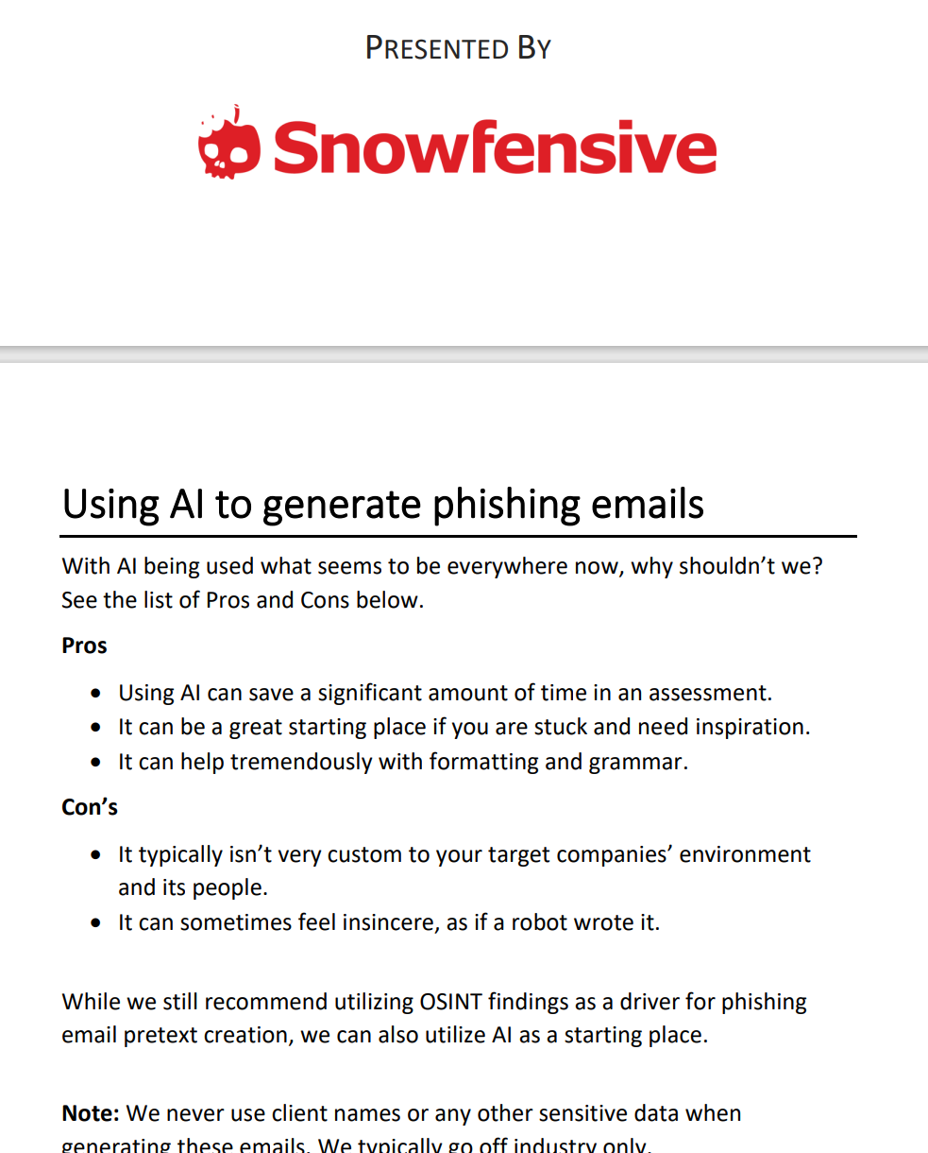
A.I. Text/Code Attacks
Organization level attacks
Rapid development of exploit code
Text generation/filter evasion
Social Engineering Text

Slide 13


Slide 14

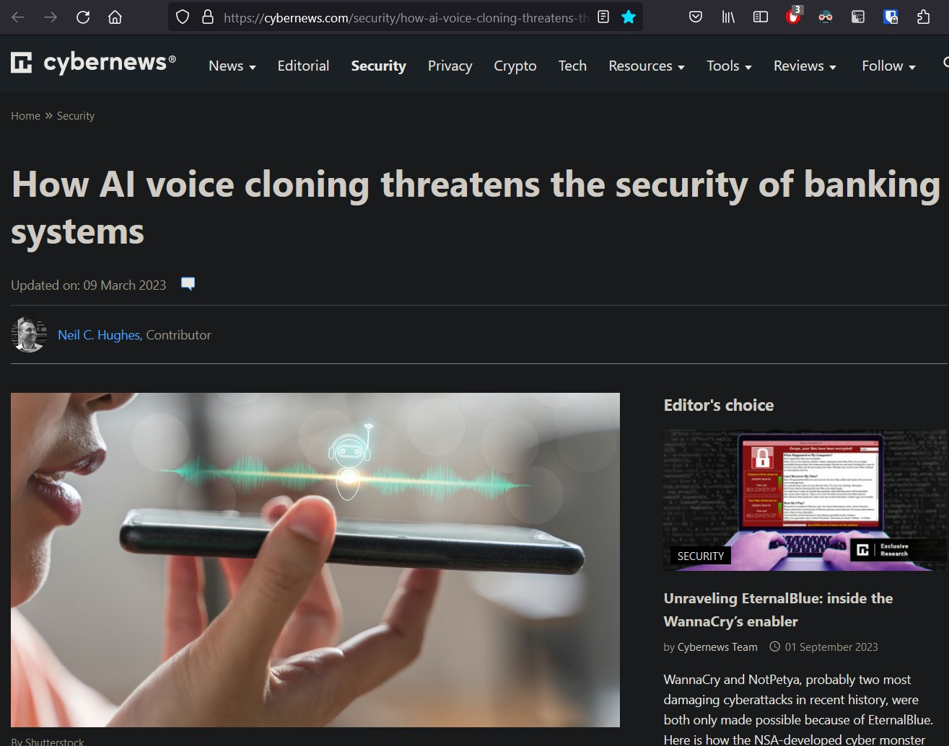
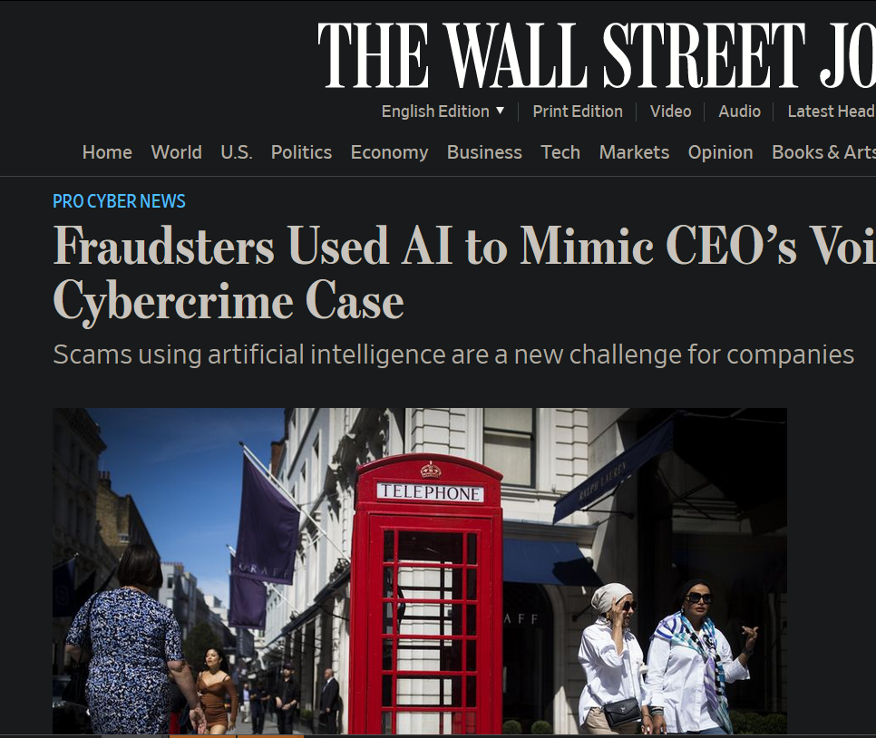
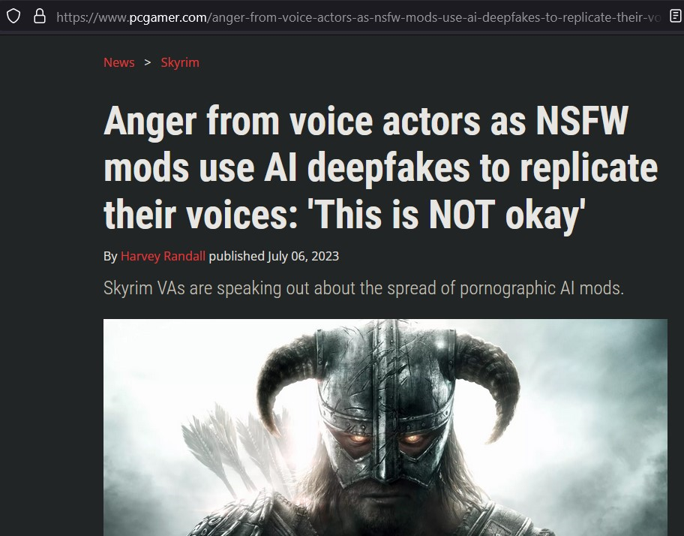
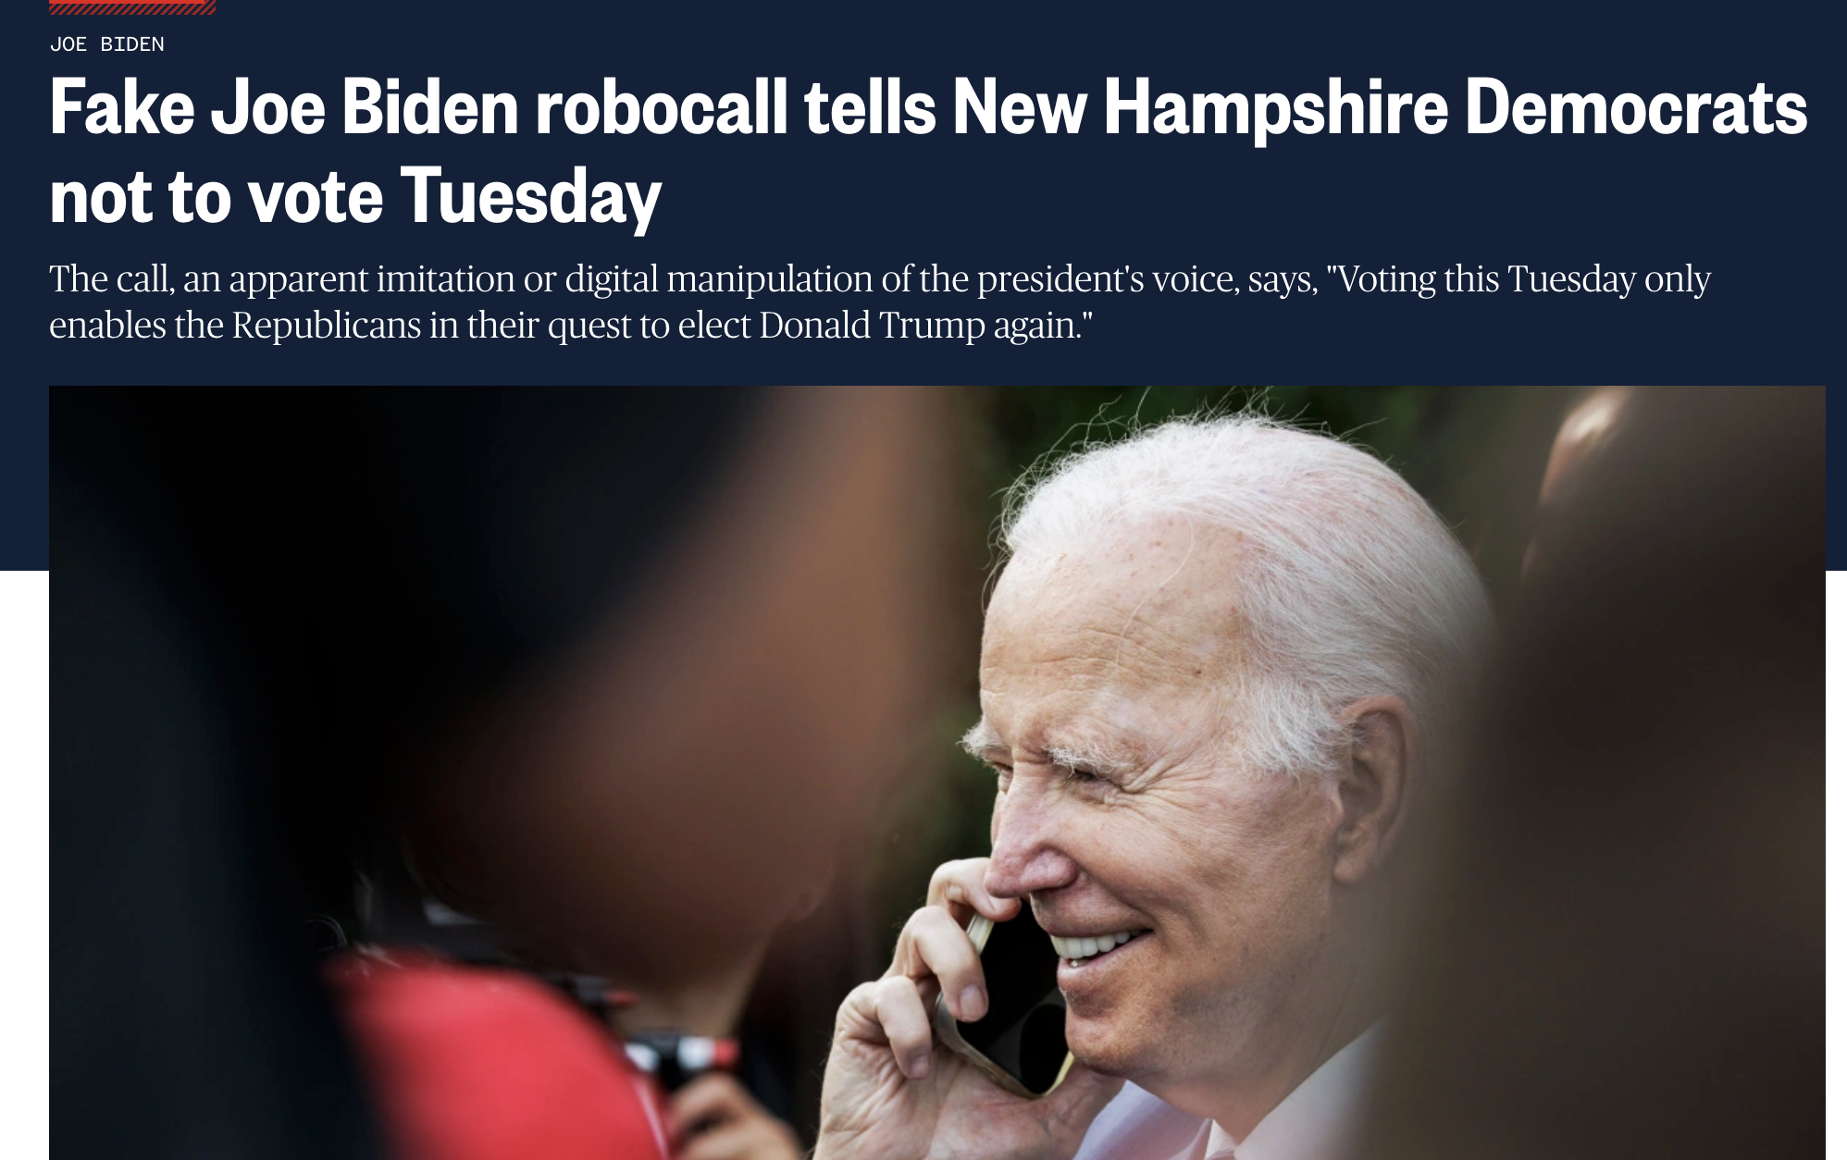
A.I. Audio Examples

Slide 15
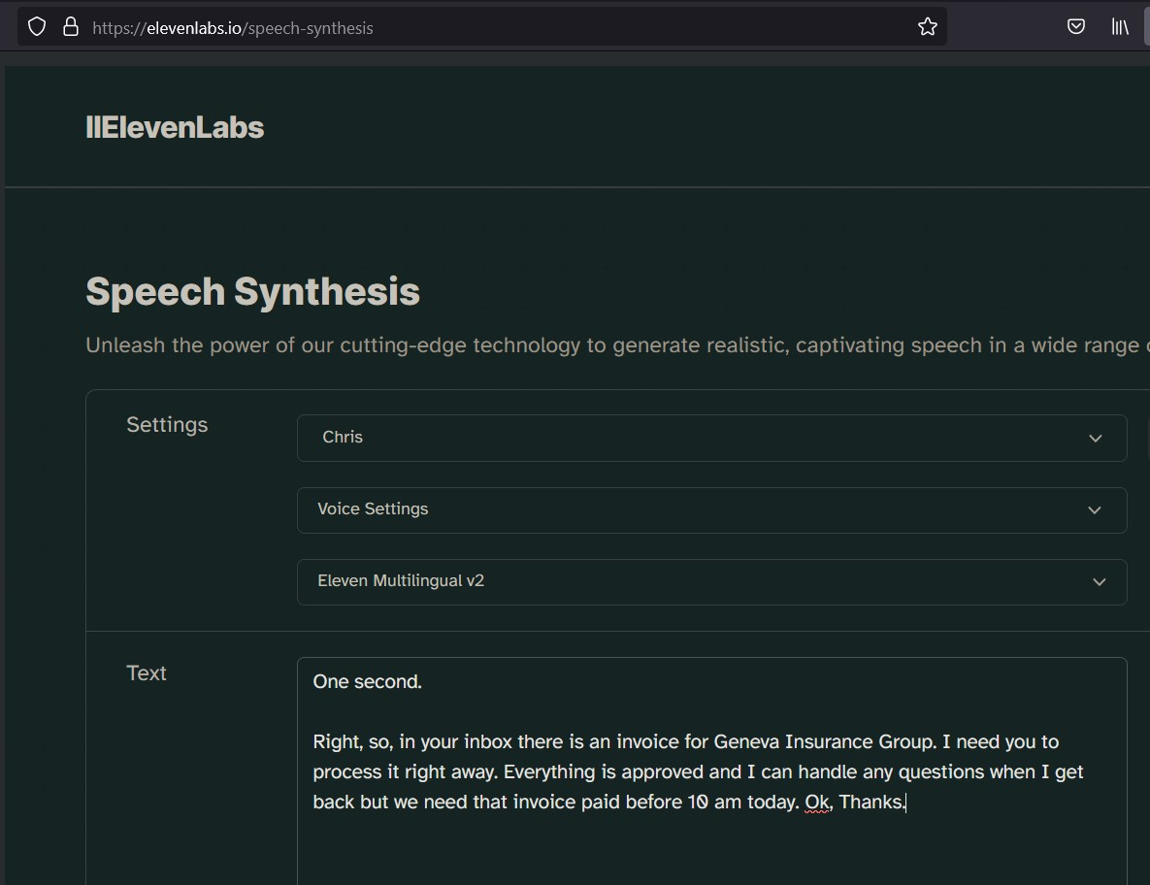
A.I. Audio Attacks
Organization level attacks
Combined Audio Phishing
Account Compromise

Slide 16

A.I. Audio Attacks

Slide 17

A.I. Audio Attacks
Organization level attacks
Combined Audio Phishing
Account Compromise

Slide 18
Current State
Breath and mouth sounds
“umms” and “uhhs”
Stammers
Pauses

Slide 19


Slide 20
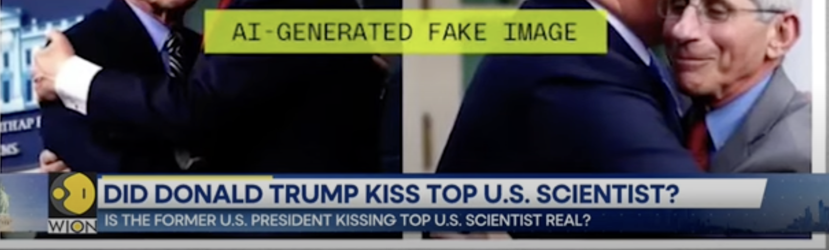
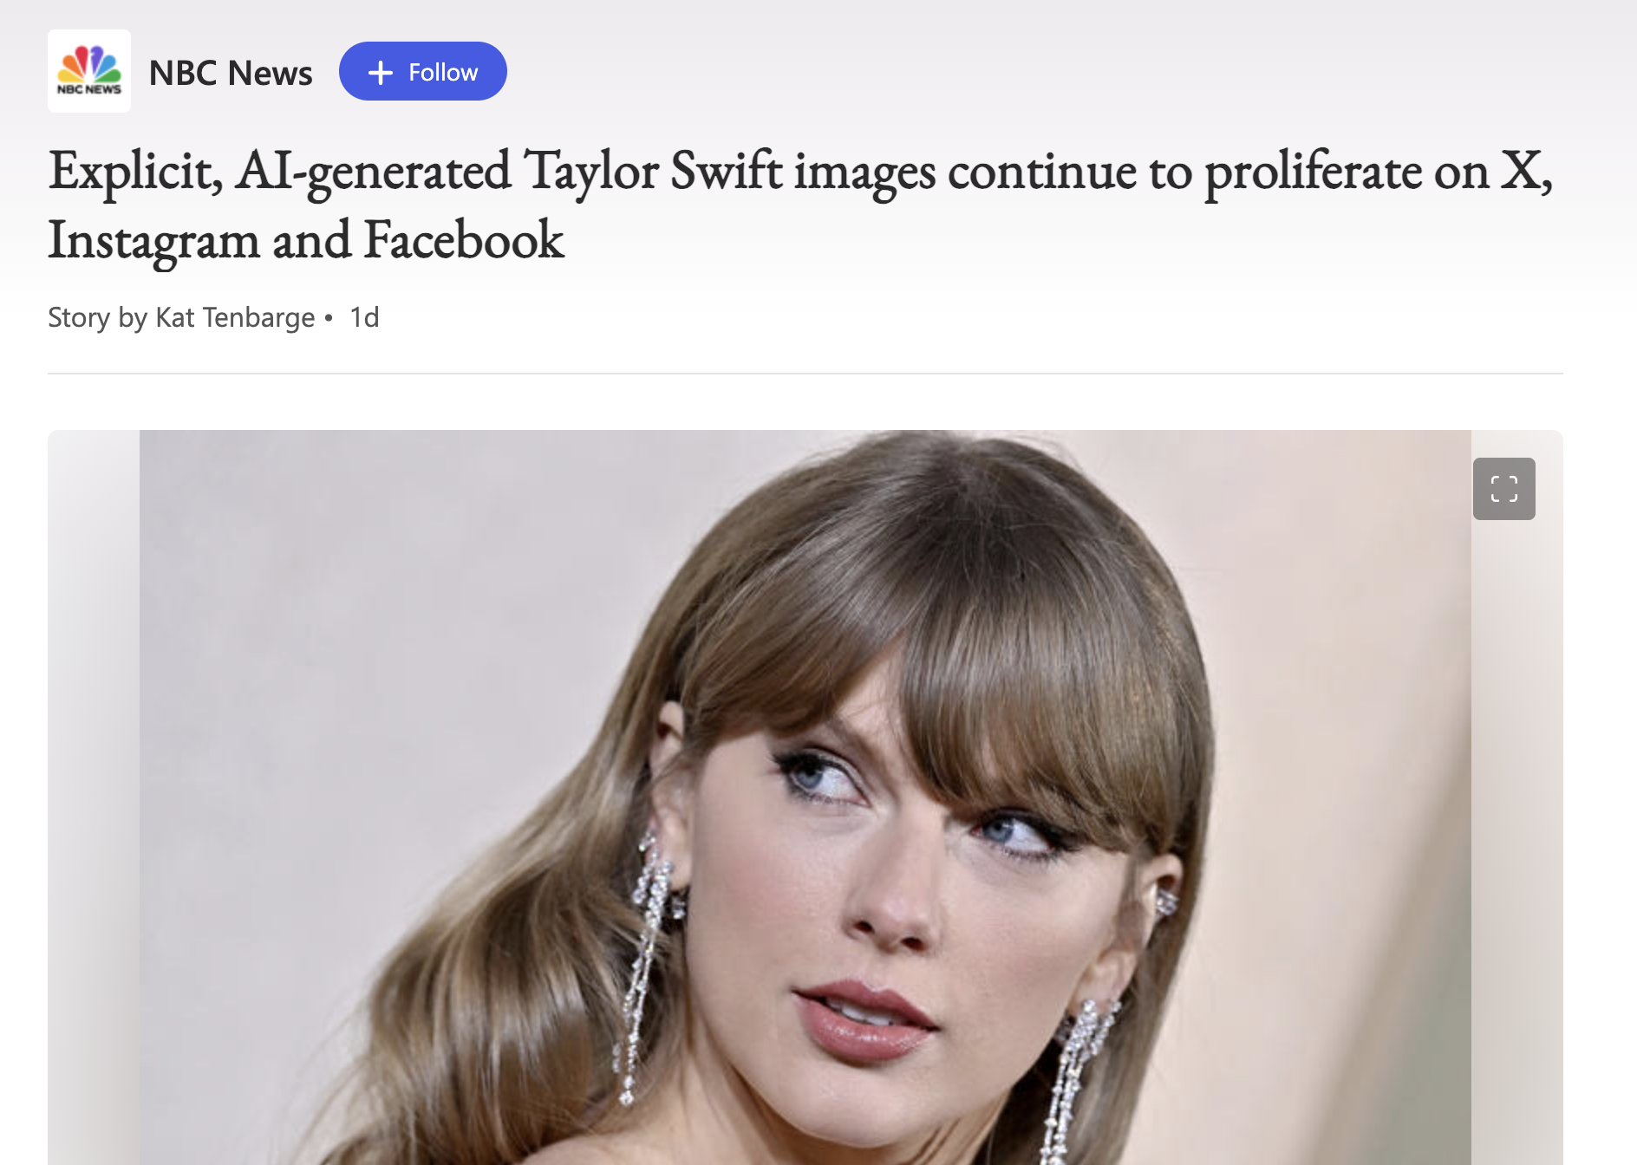
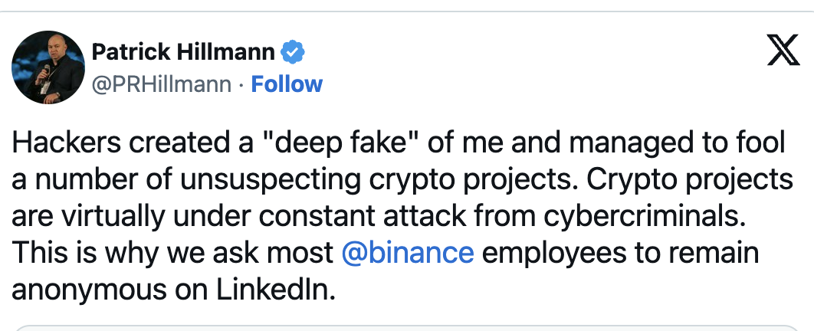
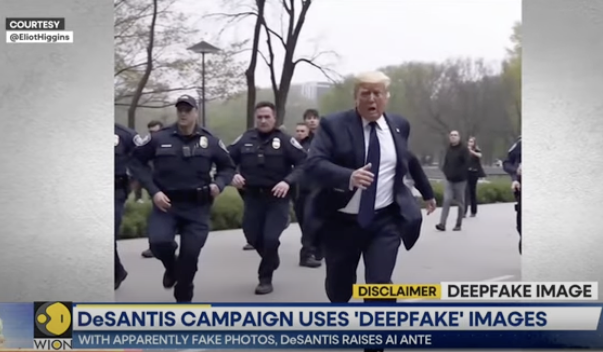
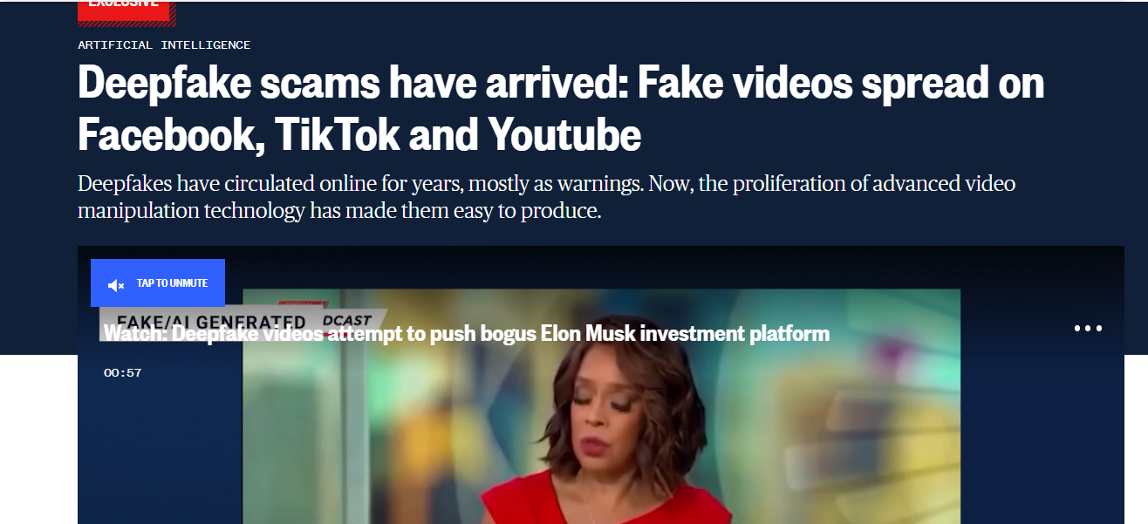
A.I. Video Examples

Slide 21


Ukraine - 2022

Slide 22

Canada - 3 Days Ago

Slide 23
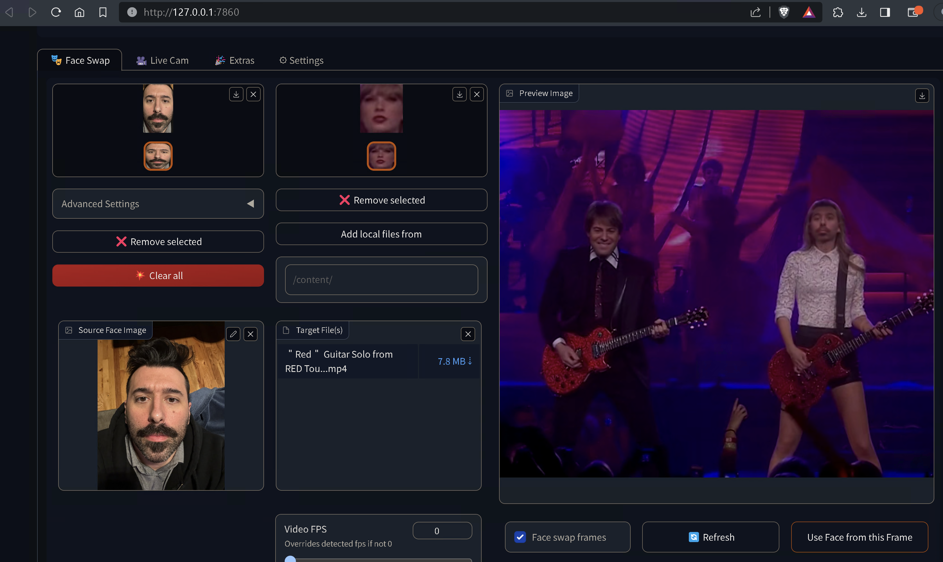
A.I. Video Attacks

Slide 24
A.I. Video Attacks

Slide 25
Disturbingly Fun Facts
GPT is the most time-intensive and error-ridden
Video is FAST
Real-time face swapping
…even on affordable consumer hardware
Higher-res is FASTER.
Audio is pretty much perfect

Slide 26
Preparing to Fight Back
Safe Words
Education
Policy
Testing

Slide 27

THANKS! + Q/A
We asked ChatGPT the top 4 most common audience questions/prompts, here’s the results:
It’s your birthday. Someone gives you a calfskin wallet.
You’ve got a little boy. He shows you his butterfly collection plus the killing jar.
You’re watching television. Suddenly you realize there’s a wasp crawling on your arm.
A tortoise lays on its back, its belly baking in the hot sun, beating its legs trying to turn itself over, but it can’t, not without your help. But you’re not helping. Why is that?
I am looking For a light at the end of the tunnel, I am looking For a god, I am looking For a way out, I am looking For strength, I am looking For a guide, I am looking For a light, I am looking for the right path, I am looking For the right path, I am looking For the right path, I am looking For the right path, I am Looking For a God, and I'll pay you for it, So, I have been looking for it, I, "I am afraid, I am, I am, I am, I am looking for a light that does not exist.

Slide 28

References / Resources
Text
ChatGPT https://openai.com
Snowfensive’s Leveraging Artificial Intelligence (Ai) To Build Phishing Pretexts Whitepaper https://snowfensive.com
Voice
Eleven Labs https://elevenlabs.io
Coqui https://coqui.ai
RVC-Project https://github.com/RVC-Project
Video
Wav2Lip https://github.com/Rudrabha/Wav2Lip
Wav2Lip Lip Sync Service https://www.neuralsyncai.com/
Video
Roop Face Swap Project https://github.com/s0md3v/roop
DeepfaceLab/Live https://github.com/iperov/DeepFaceLab/
Detection
Blade Runner https://www.bladerunner.ai/
Intel and Intel Labs Develop New AI Methods to Restore Trust in Media https://www.intel.com/content/www/us/en/research/blogs/trusted-media.html
Notes:
Anger from voice actors as NSFW mods use AI deepfakes to replicate their voices: 'This is NOT okay' https://www.pcgamer.com/anger-from-voice-actors-as-nsfw-mods-use-ai-deepfakes-to-replicate-their-voices-this-is-not-okay/#ljsu5cpya7fw8vou28v
Fraudsters Used AI to Mimic CEO’s Voice in Unusual Cybercrime Case https://www.wsj.com/articles/fraudsters-use-ai-to-mimic-ceos-voice-in-unusual-cybercrime-case-11567157402
How con artists use AI, apps, social engineering to target parents, grandparents for theft https://www.cbsnews.com/news/how-con-artists-use-ai-apps-to-steal-60-minutes-transcript/?linkId=215644785
Novel social engineering attacks soar 135% amid uptake of generative AI https://www.itpro.com/technology/artificial-intelligence-ai/370366/social-engineering-attacks-generative-ai-soar-135
How AI voice cloning threatens the security of banking systems https://cybernews.com/security/how-ai-voice-cloning-threatens-the-security-of-banking-systems/
Deepfake scams have arrived: Fake videos spread on Facebook, TikTok and Youtube https://www.nbcnews.com/tech/tech-news/deepfake-scams-arrived-fake-videos-spread-facebook-tiktok-youtube-rcna101415

